Slide 1

Predicting Superconductor Critical Temperatures
An exploration of using Principal Component Analysis (PCA) to predict the critical temperatures of superconducting materials.

Slide 2

Q. How effectively can machine learning models, enhanced with PCA, predict the critical temperature (Tc) of superconducting materials?
1.Understanding the dataset
• What are the predictors and what is the target variable
• Cleaning the data : Imputing and feature scaling
2. PCA and Dimensionality Reduction
• What is the purpose of applying PCA to the superconductivity dataset?
• How much variance do the selected principal components retain?
3. Regression Models and Comparisons
• How do different regression models perform on this dataset?
• How does model performance change when PCA is applied?
4. Hyperparameter Tuning
• What role do n_estimators, max_depth, and max_features play in Random Forest?
• How were these hyperparameters optimized?
5. Model Evaluation Metrics
• What do the R² and RMSE scores tell us about model accuracy?
• How consistent is performance across cross-validation folds?
• Which model provides the best balance of accuracy and generalization?
6. Feature Importance
• Which features are most important in predicting Tc and how stable are they across various random states?

Slide 3
1.Understanding the dataset:
• What are the predictors and what is the target variable?
• Cleaning the data : Imputing and feature scaling

Slide 4
The Superconductivity Dataset
Dataset Overview
Target Variable
Each row represents a superconducting material. The goal is to predict its critical temperature (critical_temp).
Critical_temp (Tc) is a continuous value, indicating that regression models are suitable for prediction.

Slide 5
Key Material Properties as Features
Mass of atoms
Atomic mass of constituent elements.
First ionization energy
Energy to remove an outer electron.
Radius of atoms
Atomic radius within the compound.
Material density
Density of the superconducting material.
Electron affinity
Energy change when atom gains an electron.
Heat of fusion
Heat required to melt the substance.
Thermal conductivity
How well the substance conducts heat.
Valence electron count
Number of valence electrons.

Slide 6
Key Material Properties as Features
Most features are based on elemental properties of the atoms in the compound, aggregated using various statistical methods:
Mean
Weighted Mean
Arithmetic mean across elements.
Mean weighted by atomic proportion.
Geometric Mean
Weighted Gmean
Geometric mean of properties.
Geometric mean weighted by proportion.
Entropy
Weighted Entropy
Measures dispersion of values.
Entropy weighted by proportion.
Range
Weighted Range
Max - Min value.
Range weighted by proportion.
Standard Deviation
Weighted Std
Measures spread of values.
Std dev weighted by proportion.

Slide 7
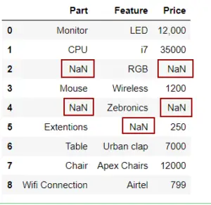
Imputing for missing values:
Missing values in a dataset can hinder model training, so it is important to handle them appropriately.
We can use the SimpleImputer class from the scikit-learn library to fill in missing values.
By creating an instance of SimpleImputer and specifying the missing_values and strategy parameters, we can replace missing entries using methods such as 'mean', 'median', or other strategies.
Here simple imputer can be used to replace the NaN values with mean,median or any other strategy

Slide 8
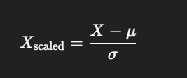
Feature Scaling for Linear,Polynomial and SVR:
Feature Scaling with StandardScaler:
Many ML models (like SVR,Linear,polynomial regression) are sensitive to the scale of input features.If one feature ranges from 0–1 and another from 0–1000, models may misinterpret importance.
What is StandardScaler?
A preprocessing tool from sklearn.preprocessing Transforms features to have:
Mean = 0
Standard Deviation = 1
Where:
𝜇 = feature mean
σ = feature standard deviation
X= the predictor variable(s)

Slide 9
Why StandardScalar and not minmaxScaler
PCA works by computing the covariance matrix of your features and finding directions of maximum variance (principal components).
But variance is sensitive to scale — features with larger ranges will dominate.
It centers each feature to have mean = 0.
It scales features to have variance = 1.
This ensures all features contribute equally to the PCA computation.
Why Not Normalization?
It does not center the data (mean ≠ 0), which breaks PCA’s math.
The shape of the data cloud becomes skewed.
might emphasize the wrong directions of variance.
Without scaling, PCA will mostly align with the high-range feature.
With MinMaxScaler, their ranges match, but their variances still differ.
With StandardScaler, their variance is made equal, giving a fair PCA.
Therefore for PCA it is always better to use StandardScalar

Slide 10
2. PCA and Dimensionality Reduction
• What is the purpose of applying PCA to the superconductivity dataset?
• How much variance do the selected principal components retain?

Slide 11
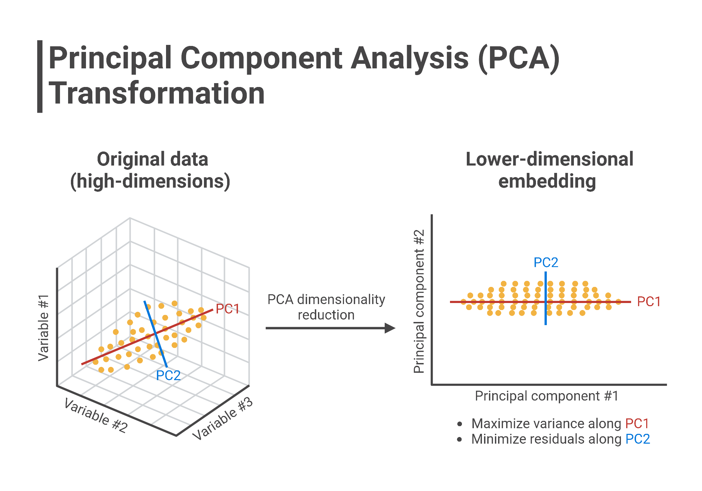
Understanding Principal Component Analysis (PCA)
1
Dimension Reduction (What it does)
PCA reduces a dataset with many features (high-dimensional space) into a smaller number of uncorrelated features (principal components) while preserving as much variance (information) as possible.
2
Uncovering New Axes (How PCA Does It)
PCA finds new axes (principal components) that are linear combinations of the original features, aligned in the directions of maximum variance in the data.

Slide 12


PCA: The Math Behind It
Given a dataset X’, a mean matrix X (mean for each row) is found. The covariance Matrix S is then calculated:
Eigenvalues (λ) are found using the characteristic polynomial. Eigenvectors corresponding to each eigenvalue are the principal component directions.
The largest eigenvalue corresponds to the principal component closest to most data, and so on.
S is a symmetric matrix with unique eigenvalues whose vectors are orthogonal.
N is the number of elements in each now .
Here tr stands for Trace ( sum of diagonal elements of a matrix).
This ratio, multiplied by 100, captures the amount of variance explained by the principal component corresponding to that eigen value

Slide 13
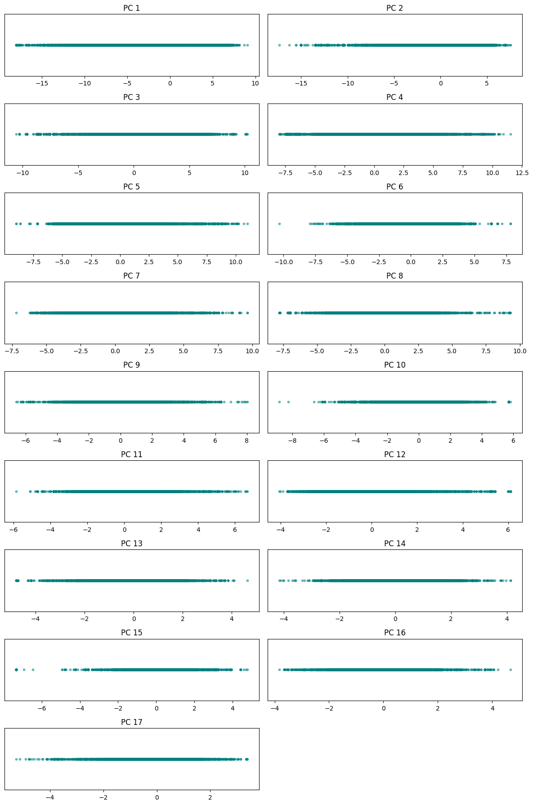

PCA Dimension Reduction Visualization
How much variance do the selected principal components retain?
17 PCA components , together they account for ~95% of the Variance in the dataset in the following order:
0.39019986, 0.1042054, 0.0953871, 0.07934556, 0.05822511, 0.03770805,0.03631953 ,0.0309735 , 0.02370823, 0.01966187, 0.01828411, 0.0146574,0.01174232, 0.00996182, 0.00987848, 0.00790938, 0.0072004

Slide 14
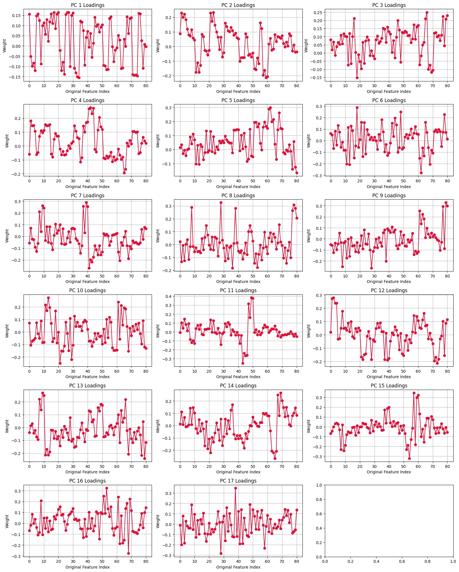
These are the loadings for 17 principal components, representing how each of the 80 original features contributes to each component.

Slide 15
3. Regression Models and Comparisons
• How do different regression models perform on this dataset?
• How does model performance change when PCA is applied?

Slide 16

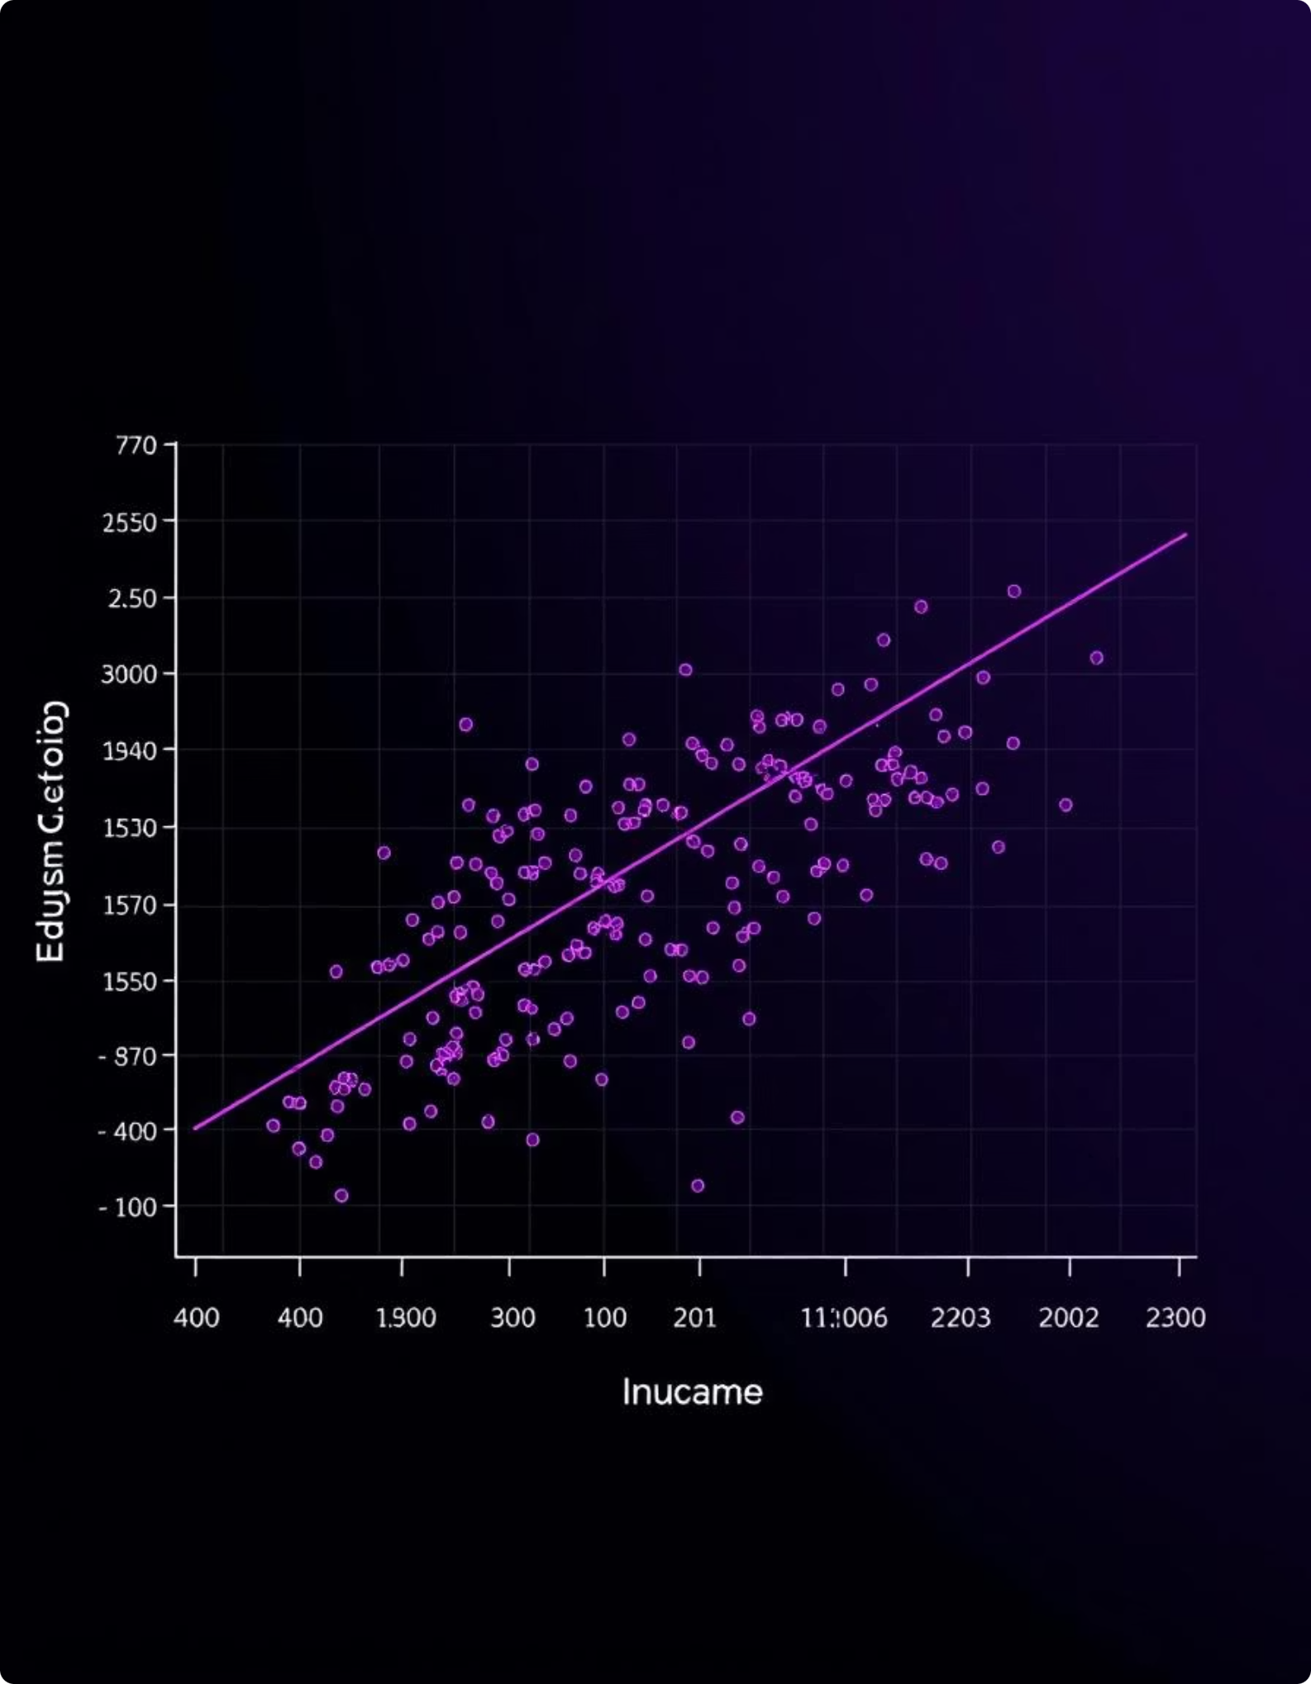

Linear Regression
Linear Regression is a fundamental supervised learning algorithm for predicting continuous target variables by modeling the linear relationship between independent and dependent variables.
1
Fitting a Line
Aims to fit a straight line (y = mx + c) that best describes the relationship between data points.
2
Variable Constraints
Primarily used for datasets with exactly one dependent and one independent variable.
Y
3
Error Minimization
The line is fitted by minimizing the sum of squared errors (RSS) between predicted (y') and actual (y) values:
X
4
Prediction
Once optimal m (slope) and c (intercept) are determined, new y values can be predicted by substituting the corresponding x values into the equation.

Slide 17

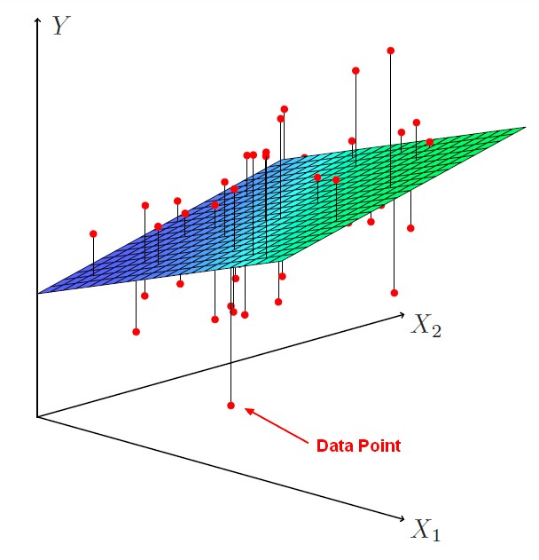
Multiple Linear Regression
Multiple Linear Regression extends simple linear regression by modeling the relationship between a dependent variable and two or more independent variables.
1
Multi-variable Extension
Similar to Linear Regression, but incorporates multiple independent variables, each with its own coefficient.
2
Plane/Hyperplane Fit
This process is akin to fitting a multi-dimensional plane or hyperplane into the coordinate system.
Error Minimization
3
The optimal plane/hyperplane is found by minimizing the sum of squared errors (RSS) between predicted and actual values:
Closest Fit
4
The objective is to position the plane/hyperplane such that it is closest to the majority of the data points in the multi-dimensional space.
General Equation
5
The general equation for Multiple Linear Regression is:

Slide 18
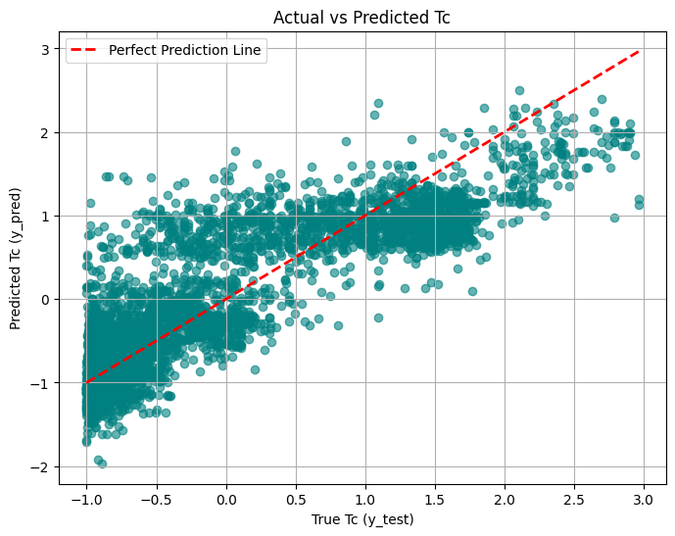
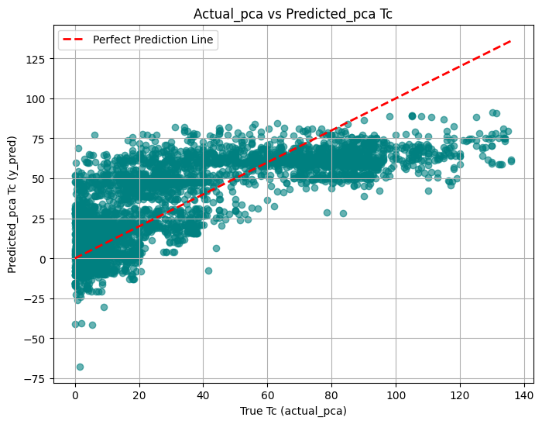
MLR on the superconductivity dataset:
How does MLR model perform on this dataset?
How does model performance change when PCA is applied?
With PCA
This plot shows predicted Tc vs expected Tc after PCA was applied to
Feature scaled dataset .
Without PCA
This plot shows Predicted Tc vs the expected Tc
These plots shows that the models performance decreases after PCA was applied.

Slide 19

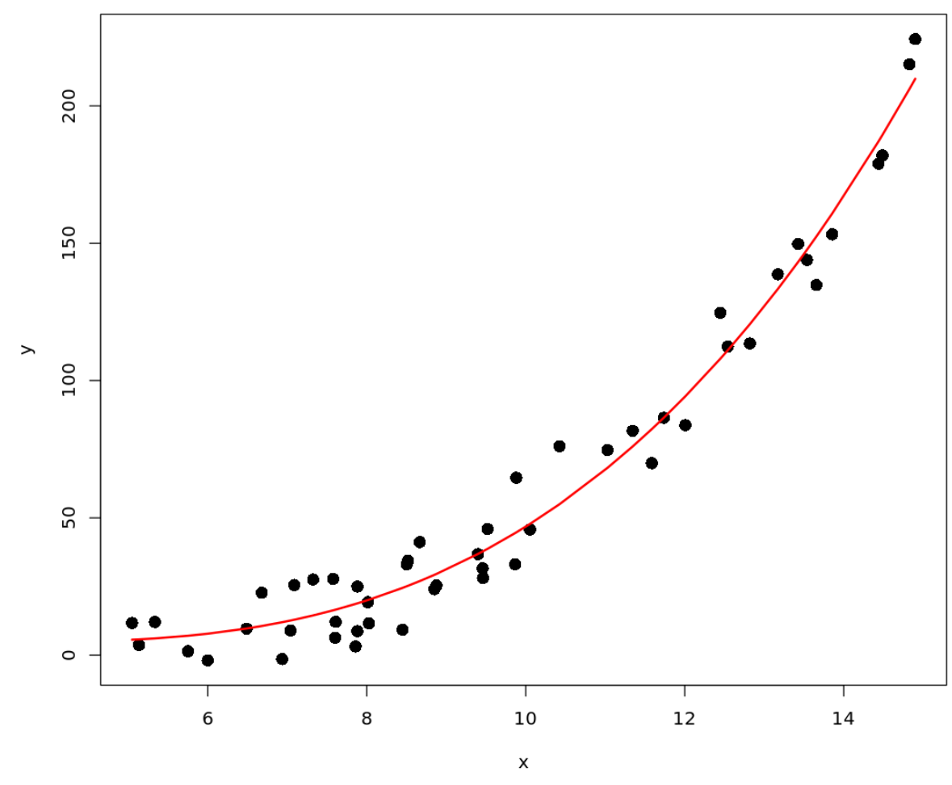



Polynomial Regression:
Polynomial Regression is a form of regression analysis that models the relationship between the independent variable(s) and the dependent variable as an nth-degree polynomial.
Modeling Non-Linearity
Coefficient Determination
Used to model non-linear relationships, capturing curves and bends in the data that linear models cannot.
The aim is to find optimal coefficients for each of the independent variables and their polynomial terms.
General Equation
The general form for a single predictor variable x is:

Slide 20
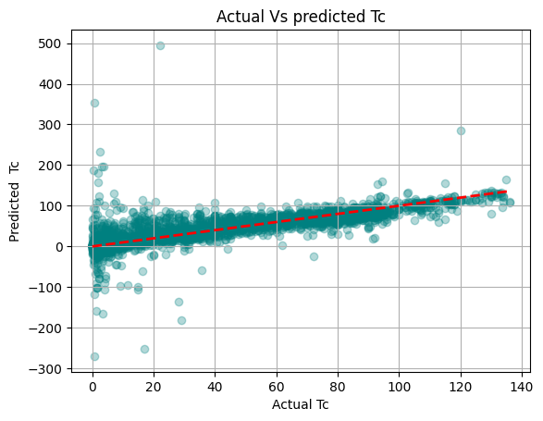
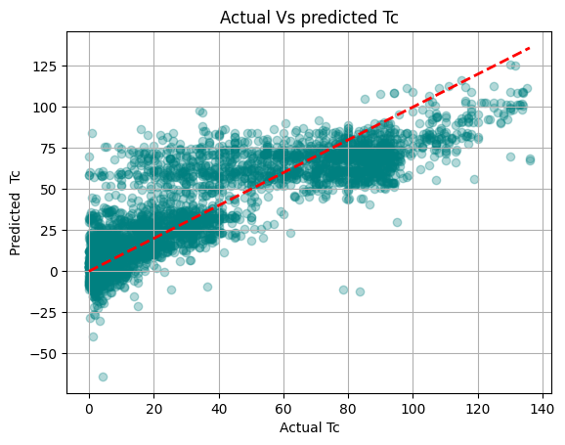
Polynomial Regression on superconductivity dataset:
How does Polynomial model perform on this dataset?
How does model performance change when PCA is applied?
With PCA
This plot shows predicted Tc vs expected Tc after PCA was applied to
Feature scaled dataset .
Without PCA
This plot shows Predicted Tc vs the expected Tc
These plots shows that the model performs better after PCA was applied than with all the features.

Slide 21
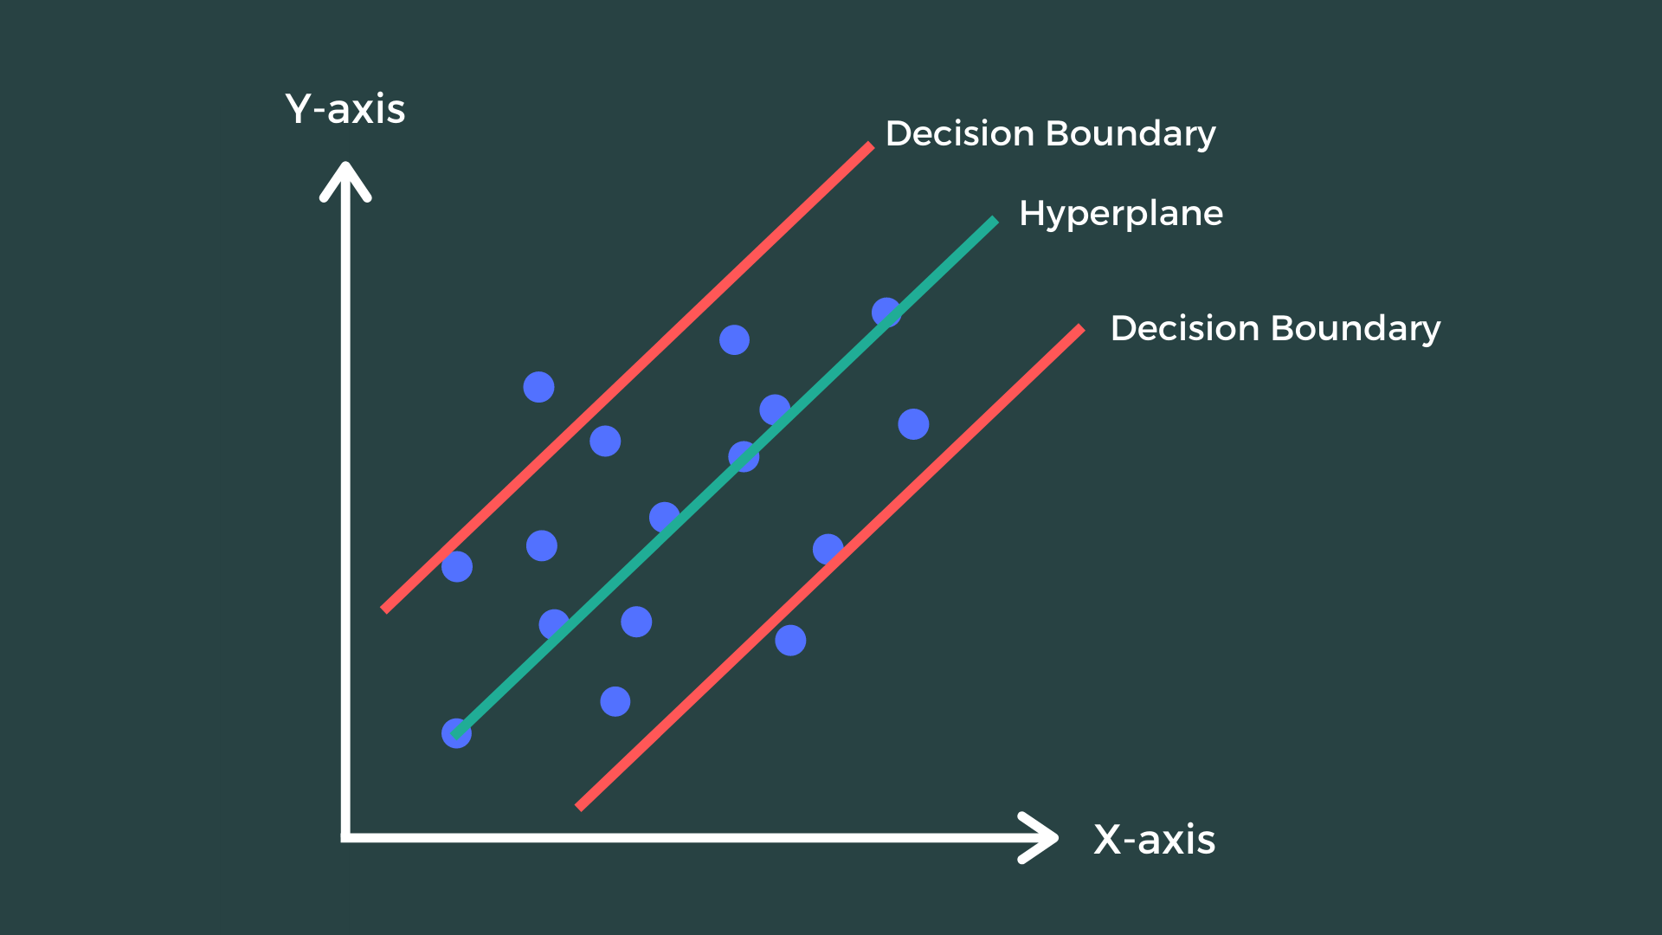
Support Vector Regression
What is SVR?
SVR is a type of Support Vector Machine (SVM) used for regression tasks instead of classification.
It aims to find a function that approximates the data within a certain margin of error (ε), rather than minimizing prediction error directly.
Epsilon (ε) Margin: A tube or margin around the regression line where no penalty is given for errors inside it.
Support Vectors: Data points that lie outside the epsilon margin. These are critical in defining the regression function.
Kernel Trick: SVR can use linear or nonlinear kernels (like RBF) to model complex relationships.
How SVR Works:
Tries to fit a line (or curve) that best captures the trend in the data.
Ensures most data points are within ε of the predicted value.
Penalizes only predictions that fall outside the ε margin using a regularization parameter C.
Hyperparameters:
C: Controls the trade-off between the flatness of the function and tolerance to error.
ε (Epsilon): Defines the width of the margin where no penalty is given.
Kernel: Specifies the function to map input data into higher dimensions (e.g., linear, RBF, polynomial).

Slide 22
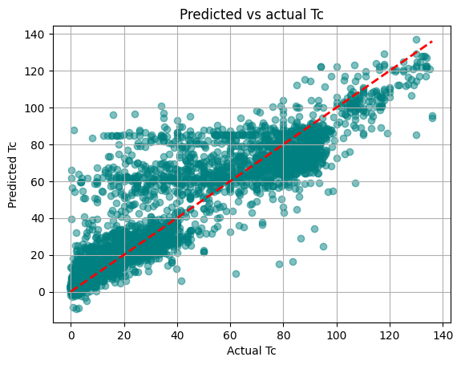
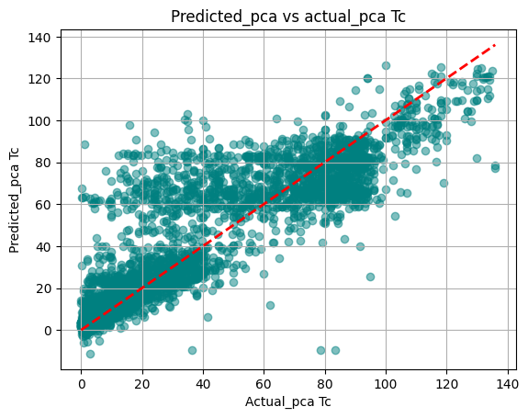
SVR on superconductivity dataset:
With PCA
This plot shows predicted Tc vs expected Tc after PCA was applied to
Feature scaled dataset .
Without PCA
This plot shows Predicted Tc vs the expected Tc
These plots show that the model's performance with and without PCA is comparable, indicating that dimensionality reduction has not significantly affected predictive accuracy.

Slide 23
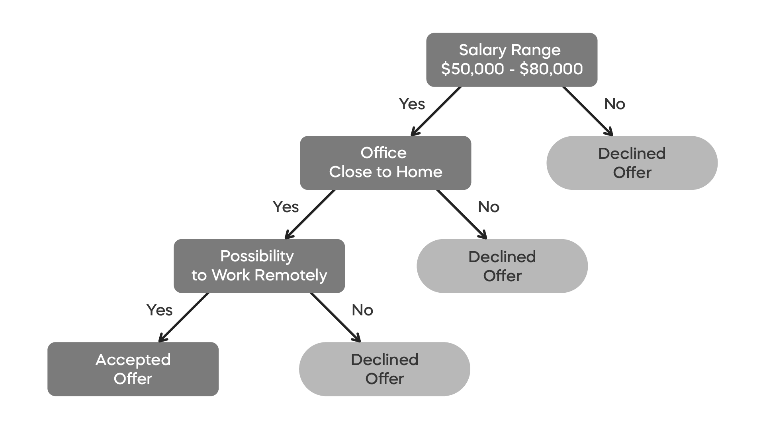
Decision Tree Regression
Decision Tree Regression is a supervised learning algorithm that models predictions by recursively partitioning the dataset into a tree-like structure.
Data Splitting
The model recursively splits the dataset into nodes, aiming to minimize the Mean Squared Error (MSE) within each resulting node.
Leaf Nodes
Splitting continues until leaf nodes are formed, which cannot be further split in a way that significantly reduces impurity or MSE.
Tree Structure
Starting from a root node (the entire dataset), data branches into child nodes, representing subsets of the dataset.
Prediction Path
Predictions are made by following a path from the root node down to a leaf node, with the leaf's value representing the output.

Slide 24
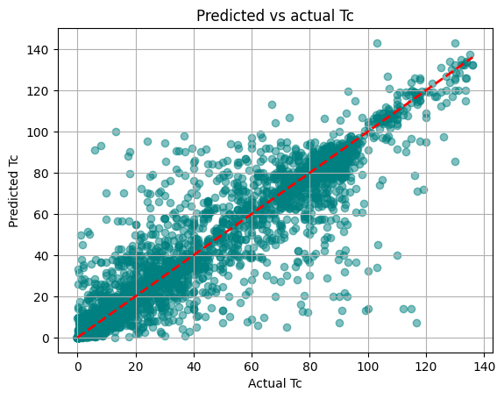
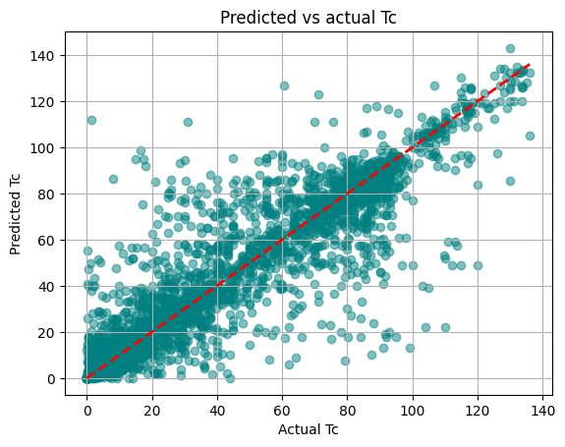
Decision Tree Modeling on superconductivity dataset:
With PCA
This plot shows predicted Tc vs expected Tc after PCA was applied to
Feature scaled dataset .
Without PCA
This plot shows Predicted Tc vs the expected Tc
These plots show that the model's performance with and without PCA is comparable, indicating that dimensionality reduction has not significantly affected predictive accuracy.

Slide 25



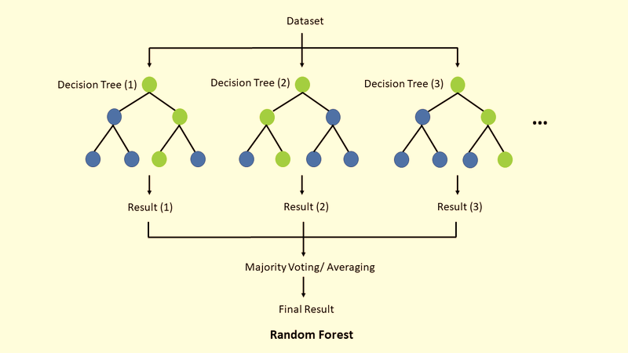
Random Forest Regression
Random Forest Regression is an ensemble learning method well-suited for predicting continuous values like critical temperatures.
Ensemble Learning
Aggregating Results
Reducing Overfitting
Builds multiple decision trees from various subsets of the training data.
Averages individual tree predictions to produce a more accurate and stable forecast.
Mitigates the risk of overfitting by leveraging the diversity of multiple trees.

Slide 26
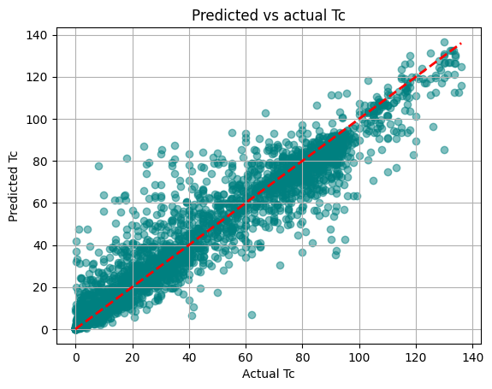
Random forest Model Performance: Predicted vs. Expected Critical Temperatures
Without PCA (82 Features)
The graph illustrates the relationship between predicted and expected critical temperatures using the full 82 features without PCA. This helps assess the model's initial fit.

Slide 27
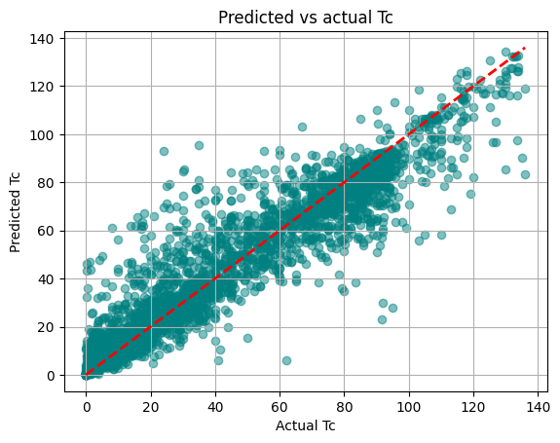
Random forest: Predicting with PCA based
dimemsion reduction
A detailed, data-driven visualization showcasing the process of predicting with PCA-based dimension reduction.
17 principle components are used which account for ~ 95% of the variance in the data comparing the two plots (with PCA and without PCA we can see that :
the model's performance with and without PCA is comparable, indicating that dimensionality reduction has negligibly affected predictive accuracy.
The graphs also show that the Random forest model is the best among the other regression models.

Slide 28
4. Hyperparameter Tuning
• What role do n_estimators, max_depth, and max_features play in Random Forest?
• How were these hyperparameters optimized?

Slide 29
Tuning the hyperparameters:
What role do n_estimators, max_depth, and max_features play in Random Forest?
The most important hyperparameters for a Random Forest model are n_estimators, max_depth, and max_features.
The R² value vs n_estimators (number of trees) often forms a plateau, where the R² doesn’t increase or increases only negligibly after a certain number of trees. Hence, using too many trees unnecessarily increases computational time without much performance gain.
The max_depth hyperparameter controls how deep each tree can go. Limiting the depth can help reduce overfitting and improve training speed by allowing trees to converge faster.
The max_features parameter improves generalization by selecting a random subset of features for each tree rather than using all features, thus also reducing computation and helping diversity among trees.
• How were these hyperparameters optimized?
These hyperparameters can be tuned manually by checking combinations or automatically using tools like GridSearchCV or RandomizedSearchCV from scikit-learn.

Slide 30
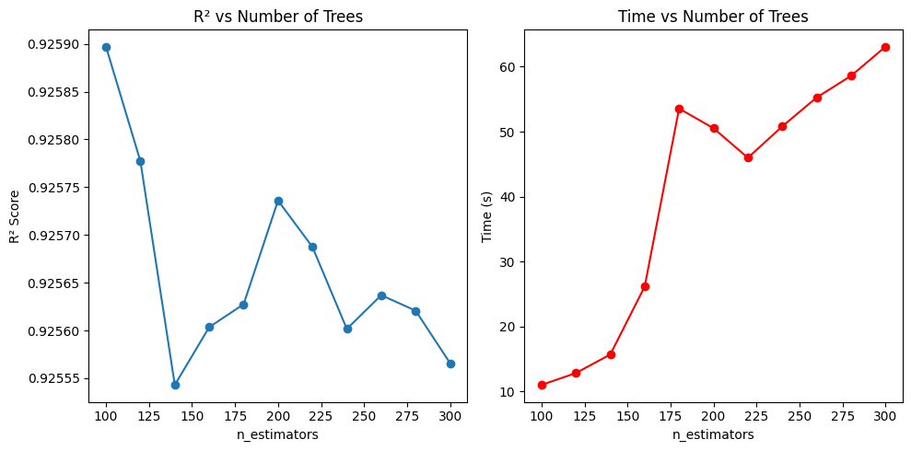
Number of trees to be used in the forest
Here , we can see that for n_estimators=100 we have an R2 about 0.92590 which decreases as the number of trees increases so n_estimators =100 is the optimal choice

Slide 31
RandomizedSearchCV
The grid search approach is fine when you are exploring relatively few combinations, like in the previous example, but when the hyperparameter search space is large, it is often preferable to use RandomizedSearchCV instead. This class can be used in much the same way as the GridSearchCV class, but instead of trying out all possible combi nations, it evaluates a given number of random combinations by selecting a random value for each hyperparameter at every iteration.
Here params_distribution is used instead of params_grid in GridSearchCV n_iter defines the number of iterations to run the search 10 here implies that the search will run 10 times each time with random values for each hyperparameter within the interval/range specified for each hyperparameter in the params_distribution
class sklearn.model_selection.RandomizedSearchCV(estimator, param_distributions, *, n_iter=10, scoring=None, n_jobs=None, refit=True, cv=None, verbose=0, pre_dispatch='2*n_jobs', random_state=None, error_score=nan, return_train_score=False)[source]

Slide 32
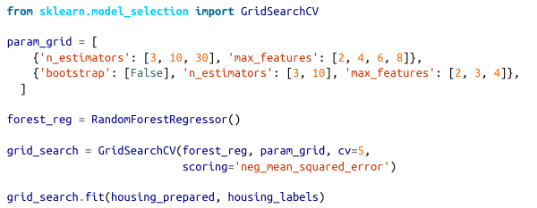
GridSearchCV
All you need to do is tell it which hyperparameters you want it to experiment with, and what values to try out, and it will evaluate all the possible combinations of hyperparameter values, using cross-validation.
This is the general format of GridSearchCV:
This will experiment with every possible combination of the hyperparameters in the param_grid and pick the one with the best r2 after cross validation

Slide 33
Tuning Hyperparameters: GridSearchCV
from sklearn.ensemble import RandomForestRegressor
from sklearn.model_selection import GridSearchCV, KFold
param_grid = {
'n_estimators': [10,50,100],
'max_depth': [15,20, 25,30],
'max_features': ['sqrt', 'log2',None]
}
rfr = RandomForestRegressor()
cv = KFold(n_splits=5, shuffle=True, random_state=42)
grid_search = GridSearchCV(estimator=rfr, param_grid=param_grid, cv=cv, scoring='r2', n_jobs=-1)
grid_search.fit(x_train, y_train.ravel())
print("Best Parameters:", grid_search.best_params_)
print("Best R² Score:", grid_search.best_score_)
This returns n_estimators= 100 max_depth=25 and max_features= ‘sqrt’ as the best features and we use random_state=0 to produce reproduceable results

Slide 34
5. Model Evaluation Metrics
• What do the R² and RMSE scores tell us about model accuracy?
• How consistent is performance across cross-validation folds?
• Which model provides the best balance of accuracy and generalization?

Slide 35
Root Mean Squared Error (RMSE)
Root Mean Squared Error (RMSE) measures the typical difference between observed values and the predicted values. It quantifies the average magnitude of the errors in a set of predictions, indicating how concentrated the errors are around the mean.
"How close are the predicted values to the actual values?"
RMSE is calculated using the formula:
Where (y_i) is the actual observed value, and (hat{y}_i) is the predicted value for the i-th observation, and n is the total number of observations.

Slide 36
R-squared
R-squared, also known as the coefficient of determination, is a key metric that measures the proportion of variance in the dependent variable that can be predicted from the independent variables. It quantifies how well the model's predictions approximate the real data points.
"How much variance in the dependent variable does the model explain?"
R-squared is calculated using the formula:
Where:
RSS (Residual Sum of Squares): Measures the sum of the squared differences between the observed and predicted values. It represents the variance unexplained by the model.
TSS (Total Sum of Squares): Measures the sum of the squared differences between the observed values and their mean. It represents the total variance in the dependent variable.

Slide 37
Comparing Various Regression Models
• How does model performance change when PCA is applied?
• Which model provides the best balance of accuracy and generalization?
Multiple Linear Regression without PCA
Multiple Linear Regression with PCA
R2 : 0.735 RMSE: 17.559
R2: 0.592 RMSE: 21.78
Polynomial Linear Regression without PCA
Polynomial Linear Regression with PCA
R2 : 0.58 RMSE: 21.333
R2 : 0.74 RMSE: 17.382
Decision Tree without PCA
Decision Tree with PCA
R2 : 0.8674 RMSE: 12.4229
R2 : 0.859 RMSE: 12.79
Random Forest without PCA
Random Forest with PCA
R2 : 0.925 RMSE: 9.854
R2 : 0.9136 RMSE: 10.027
SVR without PCA
SVR with PCA
R2 : 0.8225 RMSE: 14.369
R2 : 0.797 RMSE: 15.369

Slide 38

Cross Validation Scores
• How consistent is performance across cross-validation folds?
What is Cross-Validation?
A resampling technique used to evaluate model performance on unseen data.
Helps detect overfitting and ensures the model generalizes well.
Why Use Cross-Validation?
Ensures robust and reliable evaluation.
Reduces dependence on a single train-test split. Especially useful for tuning hyperparameters (like n_estimators, max_depth, etc.).
Common Method:
K-Fold Cross-Validation: The data is split into K equal parts (folds).The model is trained on K-1 folds and tested on the remaining fold.
This is repeated K times, each time using a different fold as the test set.
Final performance = average of all K scores.
In Random Forest:
Cross-validation helps select the best number of trees (n_estimators) or depth (max_depth) without overfitting.

Slide 39
Cross Validation Scores for our model:
We used 5-Fold Cross-Validation to evaluate the generalization performance of the Random Forest model. The dataset was split into 5 parts, where the model was trained on 4 folds and tested on the remaining fold, repeating this process 5 times.
R² Scores for Each Fold for trained model( random_state=0):
Fold 1: 0.92941499
Fold 2: 0.92271842
Fold 3: 0.92523705
Fold 4: 0.92637597
Fold 5: 0.92750683
Mean R² Score:
0.9262506492098133
This indicates that the model performs consistently across different data splits, and the high average R² suggests strong predictive power and generalization ability.

Slide 40
PCA vs. No PCA: Model Comparison for Random forest model
R² (No PCA)
0.925
R² (PCA)
0.9136
RMSE (No PCA)
9.85
RMSE (PCA)
10.027
Comparing R² and RMSE values shows that with about 17 features we can model ~91.3% of the variance as to 92.5% by 81 features without PCA.
Implying PCA can improve the models performance while retaining its goodness of fit.

Slide 41
6. Feature Importance
• Which features are most important in predicting Tc and how stable are they across various random states?

Slide 42
Feature Importance:
The method implemented in scikit-learn is based on the Breiman and Friedman's CART (Breiman, Friedman, "Classification and regression trees", 1984), the so-called mean impurity decrease.
Here, the importance value of a features is computed by averaging the impurity decrease for that feature, when splitting a parent node into two child nodes, across all the trees in the ensemble.
Note that the impurity decrease values are weighted by the number of samples that are in the respective nodes. This process is repeated for all features in the dataset, and the feature importance values are then normalized so that they sum up to 1.

Slide 43
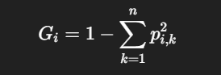
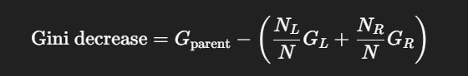
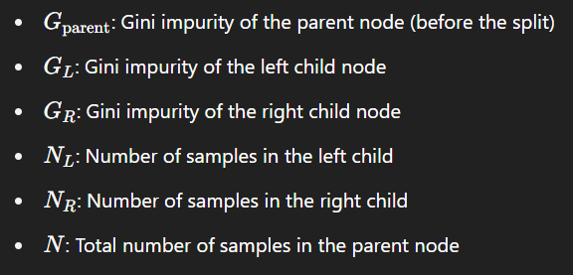
At each split in the tree, Gini impurity is calculated:
where 𝑝𝑖,𝑘 is the proportion of class 𝑘 in node 𝑖.
When a feature is used to split, we compute the Gini impurity reduction:
Where,
This decrease is attributed to the feature that caused the split.

Slide 44
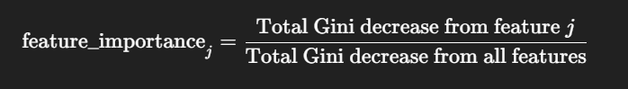
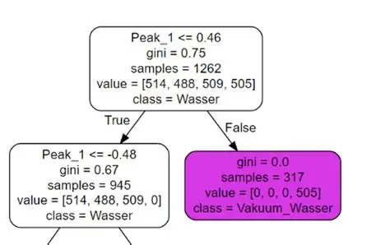
If a feature is used multiple times, its total contribution is the sum of all Gini decreases it caused. Finally,importances are normalized so they sum to 1:

Slide 45
Top Feature Importance Scores
A detailed breakdown of the 20 features most influential in predicting the critical temperature (Tc) in the Random Forest model:
Rank | Feature | Importance
1 | range_ThermalConductivity | 0.088385
2 | wtd_std_ThermalConductivity | 0.066921
3 | range_atomic_radius | 0.053730
4 | std_ThermalConductivity | 0.052412
5 | wtd_gmean_Valence | 0.049537
6 | mean_Valence | 0.040668
7 | wtd_mean_Valence | 0.040234
8 | wtd_entropy_Valence | 0.034892
9 | entropy_Valence | 0.034084
10 | wtd_entropy_atomic_mass | 0.033579
11 | wtd_mean_ThermalConductivity | 0.026898
12 | gmean_Density | 0.026831
13 | wtd_entropy_FusionHeat | 0.020025
14 | range_fie | 0.019747
15 | wtd_std_ElectronAffinity | 0.019642
16 | wtd_gmean_ThermalConductivity | 0.017974
17 | wtd_entropy_atomic_radius | 0.015910
18 | wtd_std_Valence | 0.015320
19 | wtd_gmean_ElectronAffinity | 0.012450
20 | wtd_std_fie | 0.012417

Slide 46
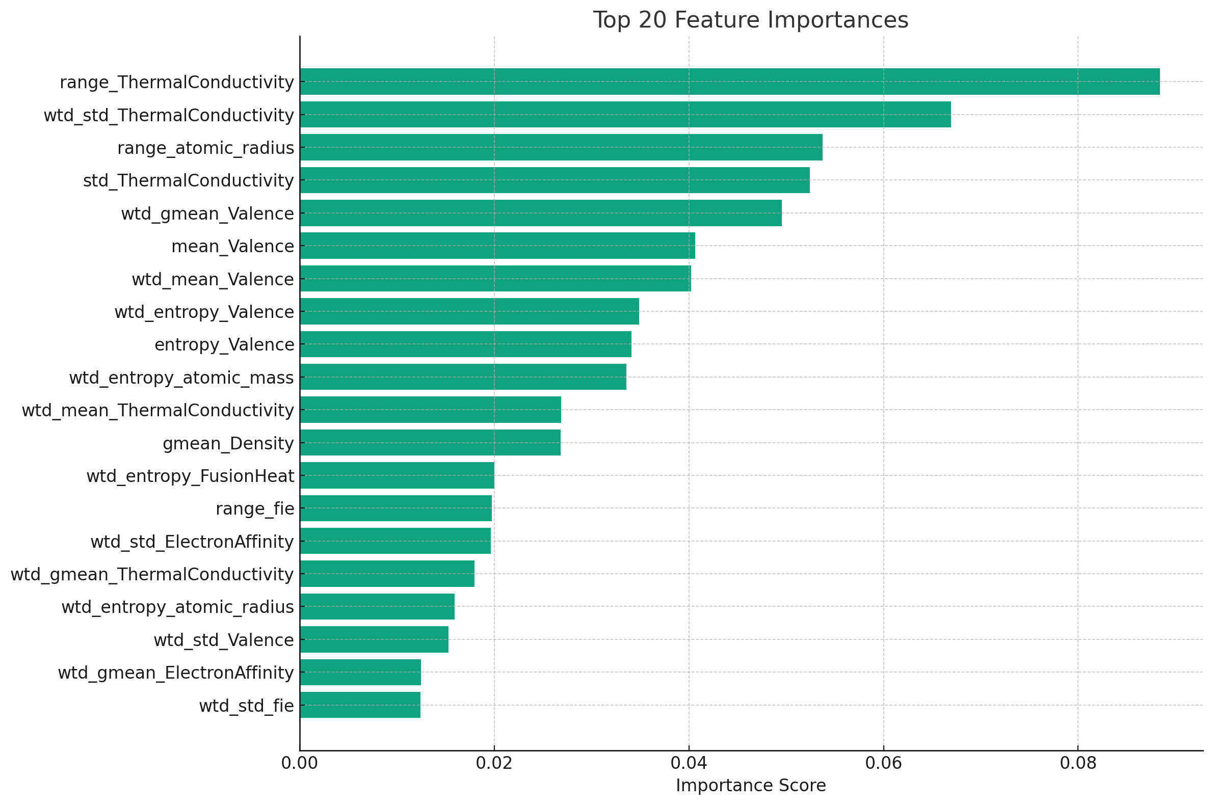
Feature Importance Analysis: Key Drivers of Tc
The features that contribute the most to a superconductor’s critical temperature
The range thermal Conductivity stands out as the most dominant feature, accounting for about 8% of the predictive power.
Other factors, such as range atomic radius, wtd std ThermalConductivity, wtd mean Valence, wtd entropy valence and the other features also contribute significantly

Slide 47
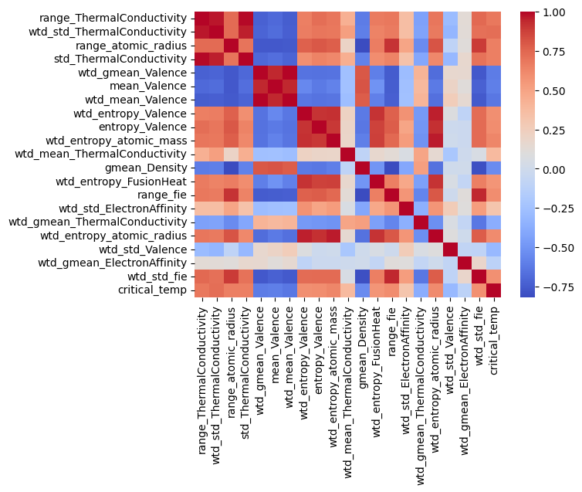
Feature
Importance
Analysis:
Correlation
Matrix

Slide 48
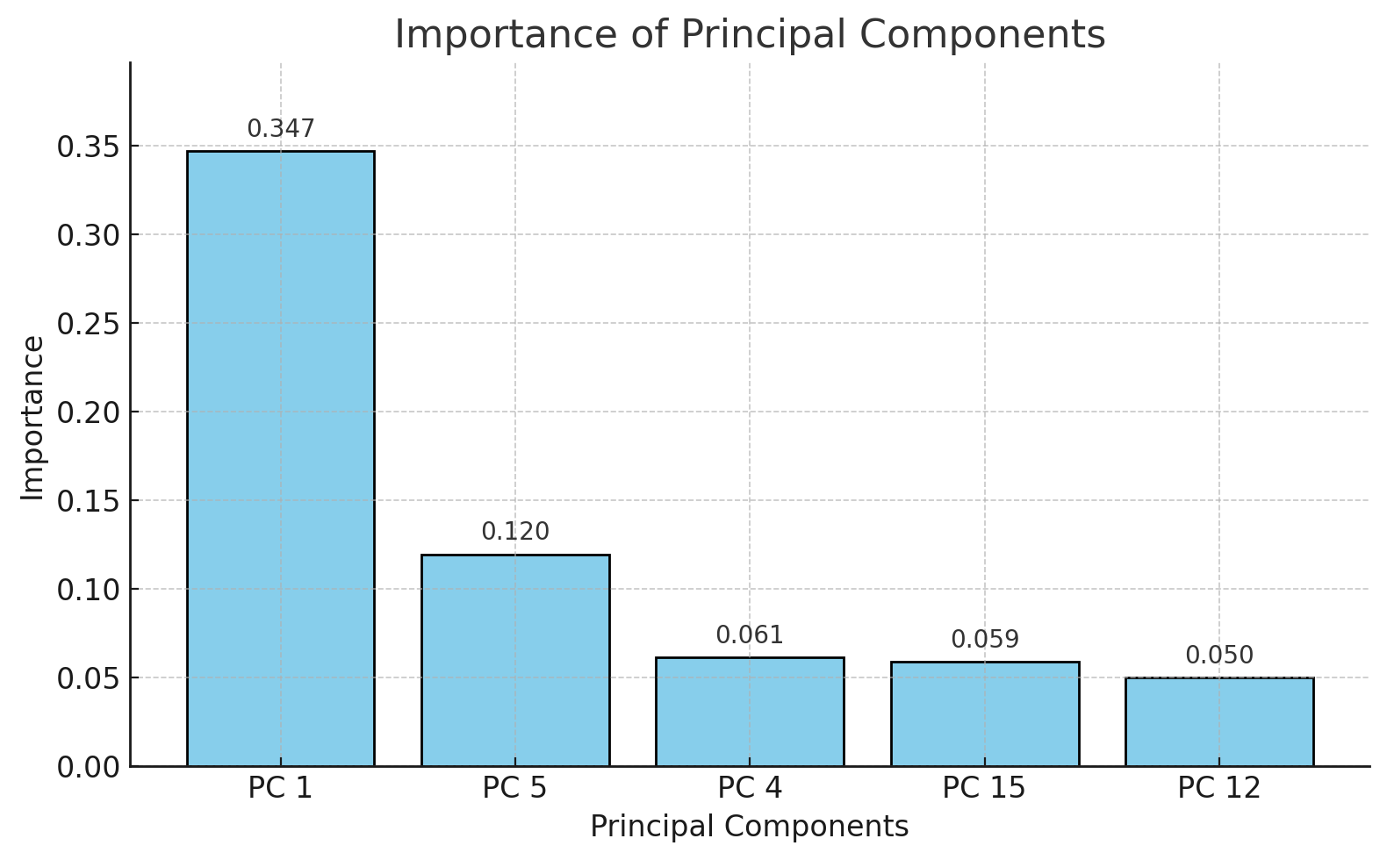
PCA Feature Importance: Key Drivers
After applying Principal Component Analysis (PCA) for dimensionality reduction , the most important/ the five Principal components that contribute
the most in the Random forest model
Principal Component | Importance
PC 1 | 0.3473
PC 5 | 0.1196
PC 4 | 0.0614
PC 15 | 0.0591
PC 12 | 0.0499

Slide 49

Feature Selection based on feature importance
Since only 49 features account for about 95% of the importance, we can remove the remaining 31 features have an effect of less than 5% on the critical temperatures of the superconductors.
Using only these 49 features , we get this graph with an r2 of 0.924 which is almost the same as that of 0.925 with all 80 features.

Slide 50
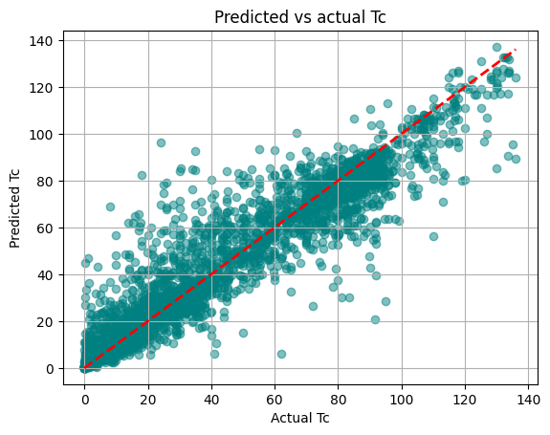
PCA after Feature Selection using feature
importance
Here after selecting 49 features we get 15 principle component that account for 95% of the variance in the dataset with 49 features.
The R2 is 0.914 which is very close to the r2 with all the 80 features .

Slide 51
R2 comparison with and without
feature selection and PCA
Model | Features Used | PCA Applied | R² Score
1 | All 80 | ❌ No | 0.925
2 | All 80 | ✅ Yes | 0.9136
3 | 49 Selected | ❌ No | 0.924
4 | 49 Selected | ✅ Yes | 0.914

